Slide 1

SMART HIRING SYSTEM
REPORT OF PROJECT SUBMITTED FOR THE DEGREE OF
MASTER OF COMPUTER APPLICATION
By
ANITESH SAHA
Registration no –231170510006 University roll no –11771023006
HRITIK DEY
Registration no –231170510024 University roll no –11771023024
TANISHA ROY
Registration no –231170510060 University roll no –11771023060
ARPITA SAHA
Registration no –231170510069 University roll no –11771023070
UNDER THE SUPERVISION OF
Mr. SUBHASIS CHOWDHURY
Assistant Professor
Department of CA, RCCIIT
AT
RCC INSTITUTE OF INFORMATION TECHNOLOGY
[Affiliated to Maulana Abul Kalam Azad University of Technology, West Bengal]
CANAL SOUTH ROAD, BELIAGHATA, KOLKATA – 700 015

Slide 2



SMART HIRING
SYSTEM
RCC INSTITUTE OF INFORMATION TECHNOLOGY
Canal South Road, Beliaghata, Kolkata-700015

Slide 3

INTRODUCTION
The Smart Hiring System is an advanced recruitment platform built using Python, NLP, and Streamlit. It connects the job seekers with the recruiters seamlessly. Candidates can apply for jobs and track their application in real-time. As for companies, it automates job advertisements, resume parsing, shortlisting, and interview scheduling. Administrators ensure smooth and secure data handling with respect to the operations of the platform.

Slide 4

OBJECTIVE & MOTIVATION
The project aims to simplify recruitment by automating resume parsing, shortlisting, and interview scheduling which reduces manual work and improving accuracy. It provides a secure, user-friendly platform that connects job seekers and recruiters, making the hiring process faster, more efficient, and transparent for both.

Slide 5

SYSTEM FEATURES
Profile creation and management
Set Job Requirement details and Post Job Openings
Resume Upload and Analysis
Real time application tracking and notifications
Candidate Shortlisting
Download Resumes and Basic details
Send Selection Mail
Schedule Interview by Company HR
Auto Generate Interview Link
Secure Data Management

Slide 6
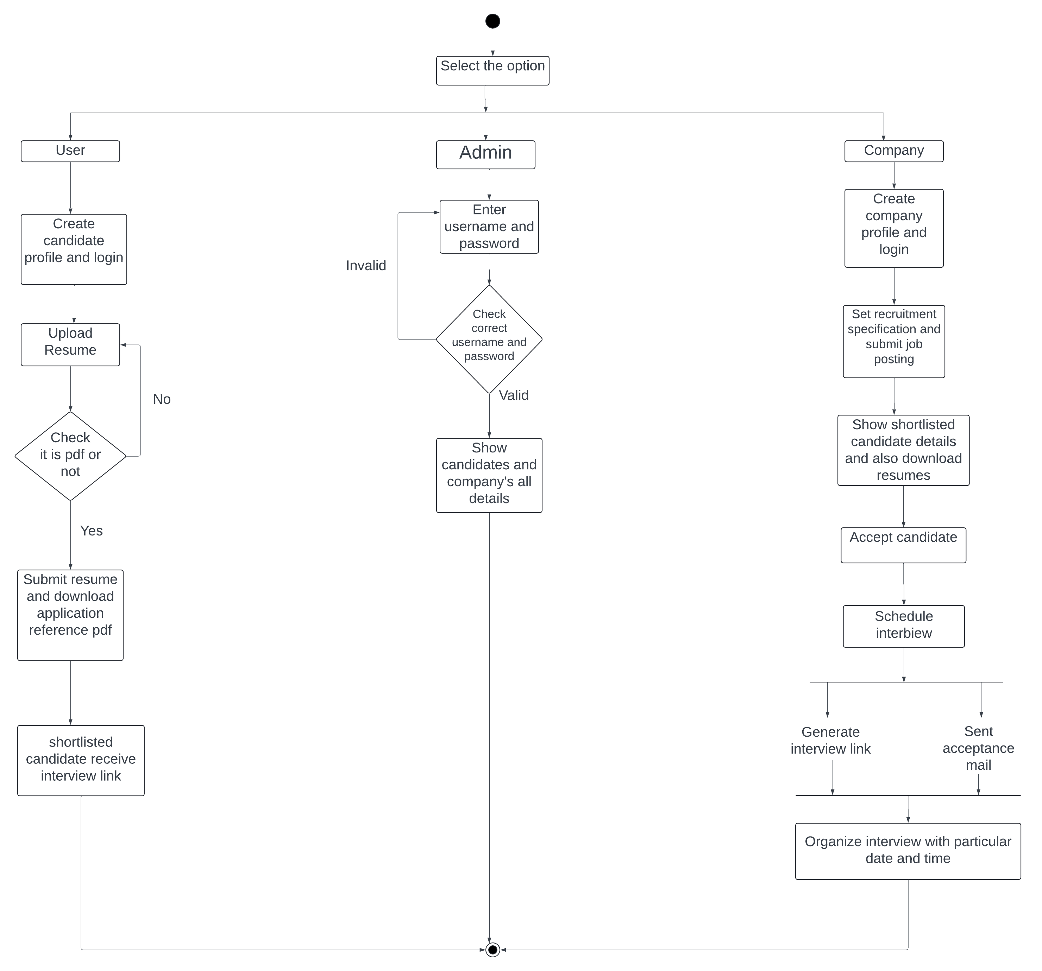
UML DIAGRAM
Activity
diagram

Slide 7

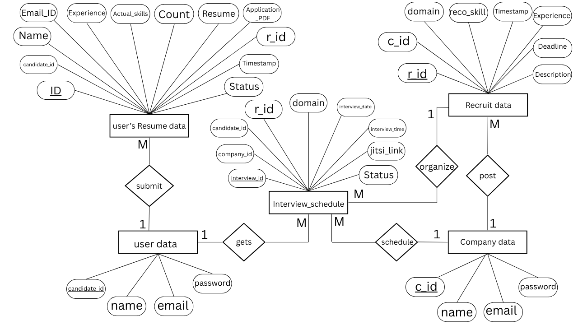
ERD(Entity-Relationship Diagram)

Slide 8
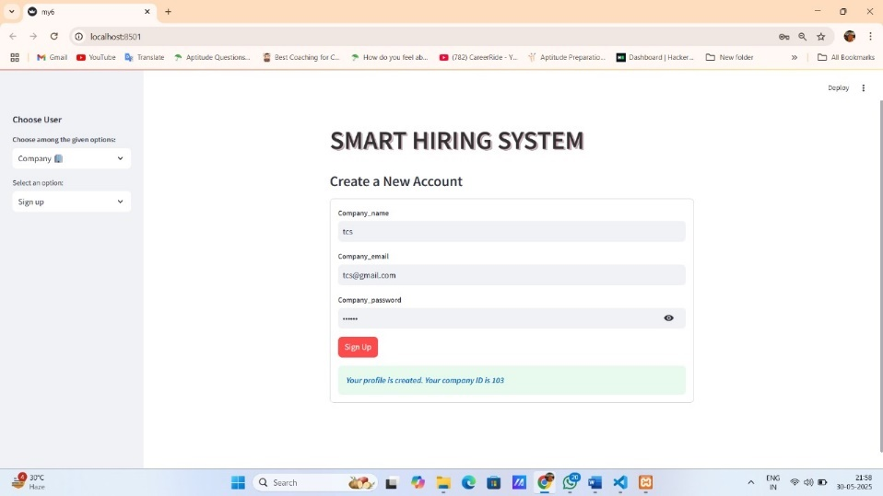
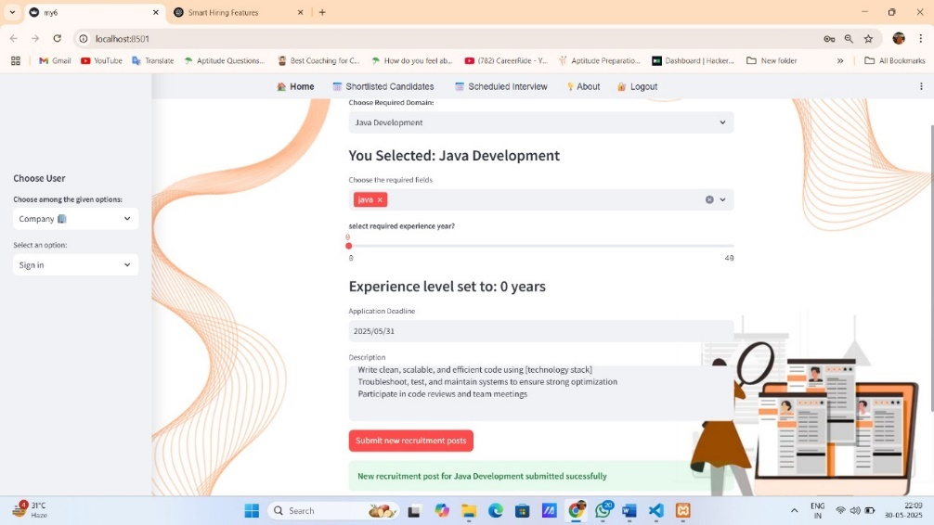
SYSTEM OUTPUT
: Register Company
Set Recruitment Specification:

Slide 9
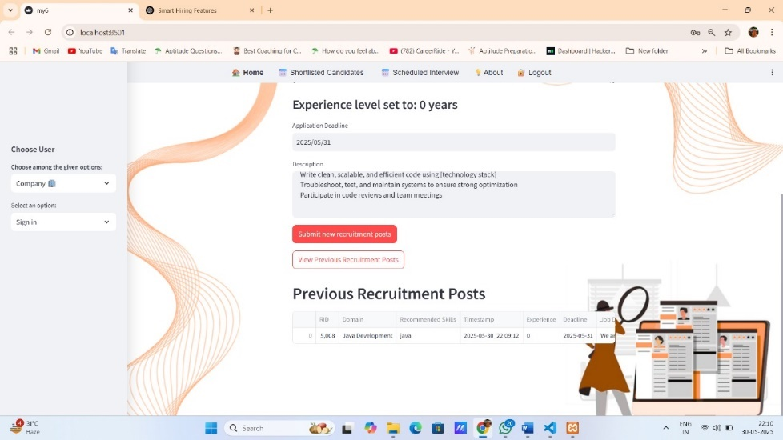
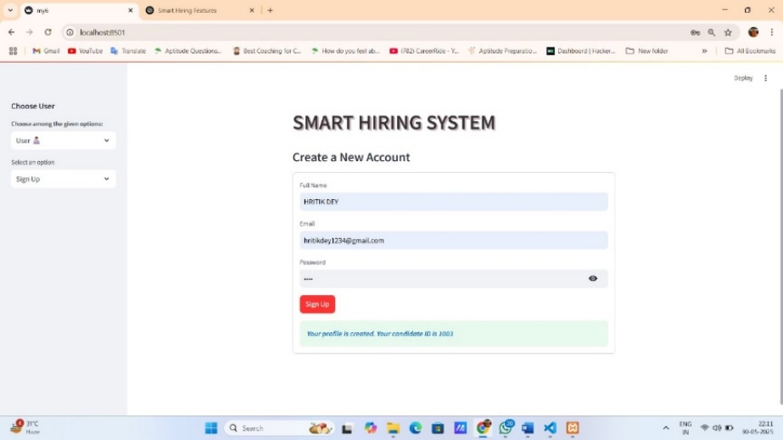
SYSTEM OUTPUT
: View Previous Recruitment Post
Create Account by User :

Slide 10
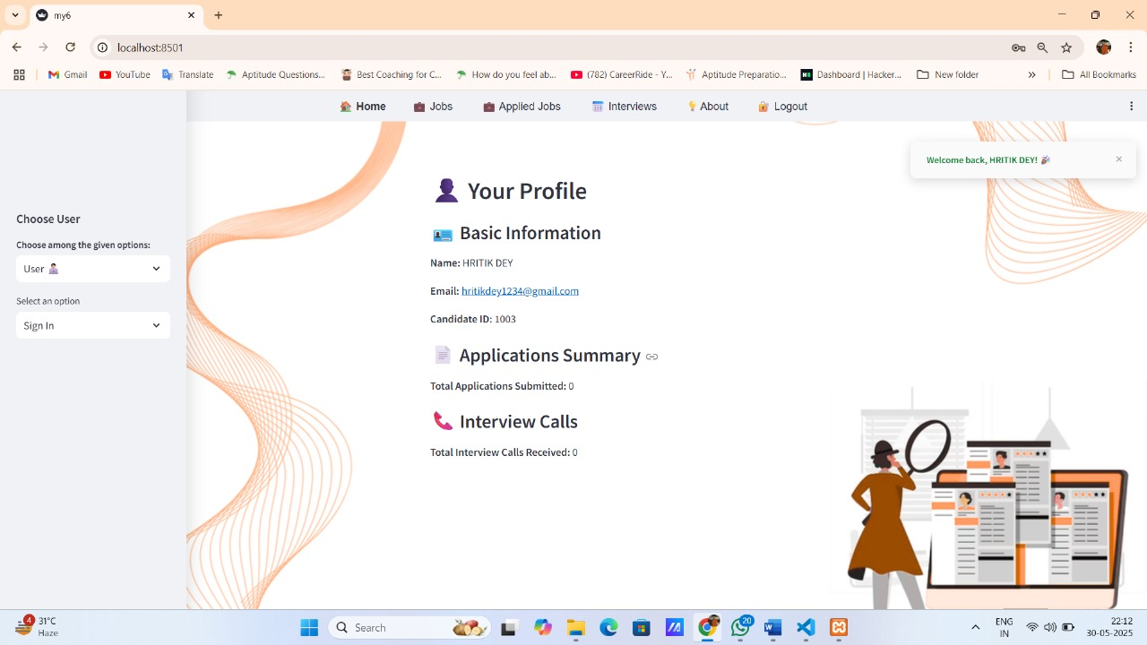
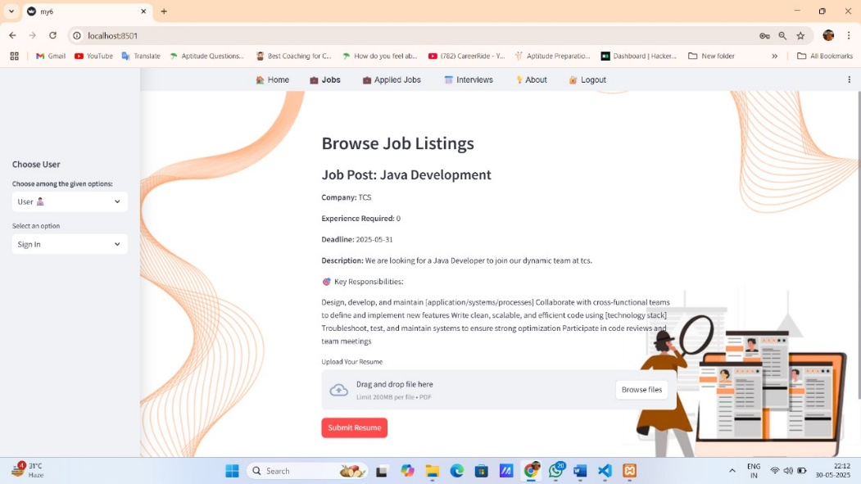
SYSTEM OUTPUT
:User Profile
Job Openings:

Slide 11
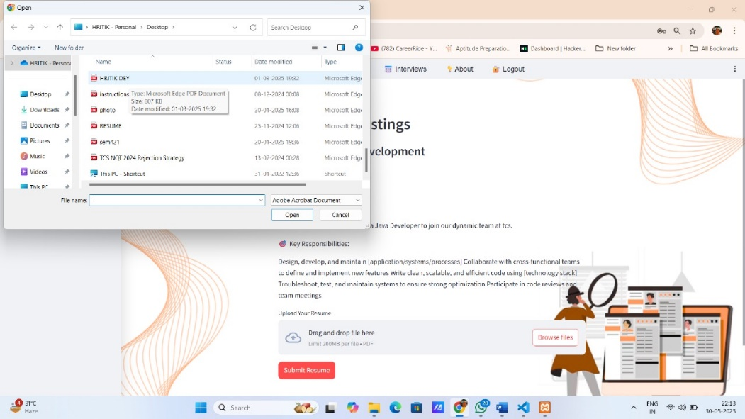
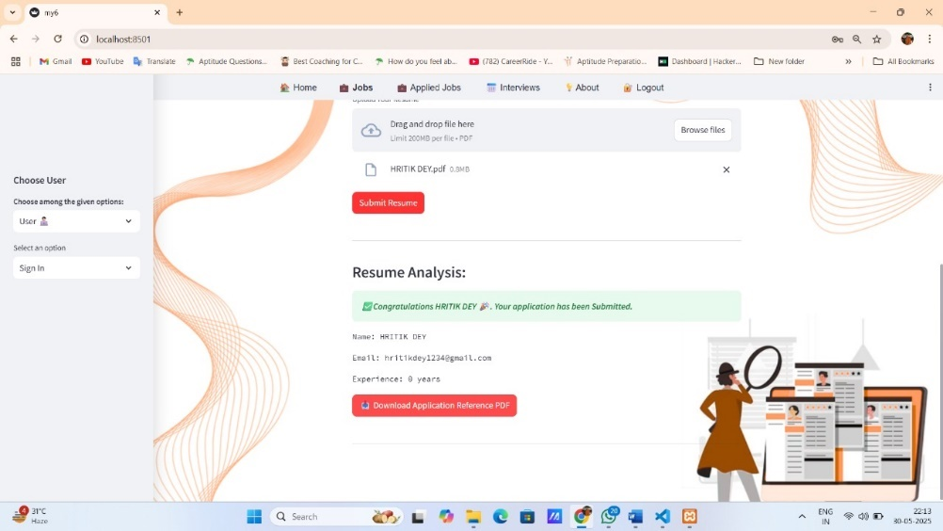
SYSTEM OUTPUT
: Resume Submission
Resume Submission
Confirmation:

Slide 12
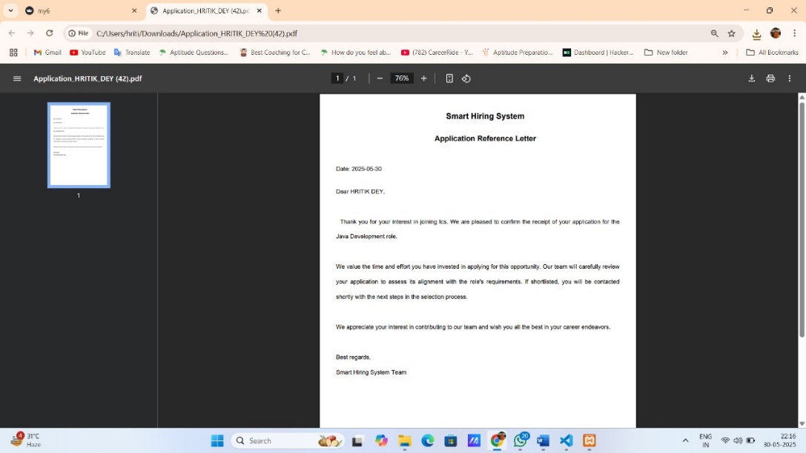
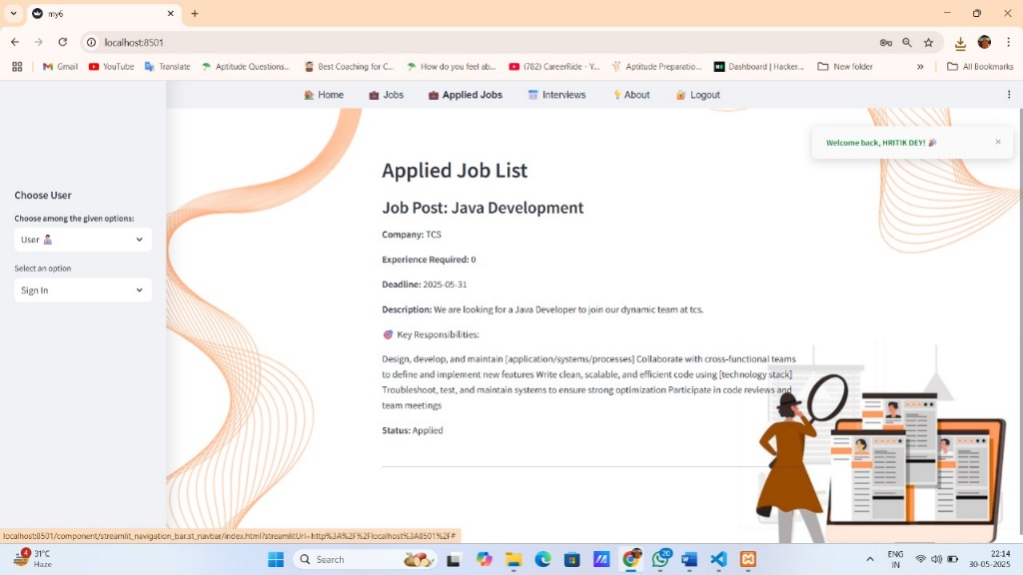
SYSTEM OUTPUT
: Application Reference PDF
Applied Job List:

Slide 13
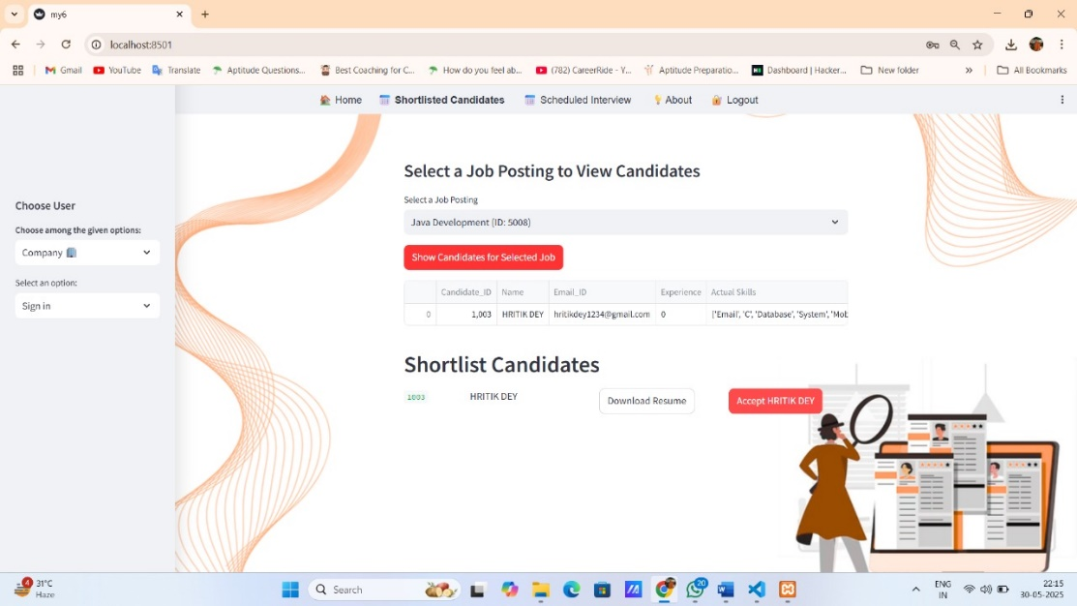
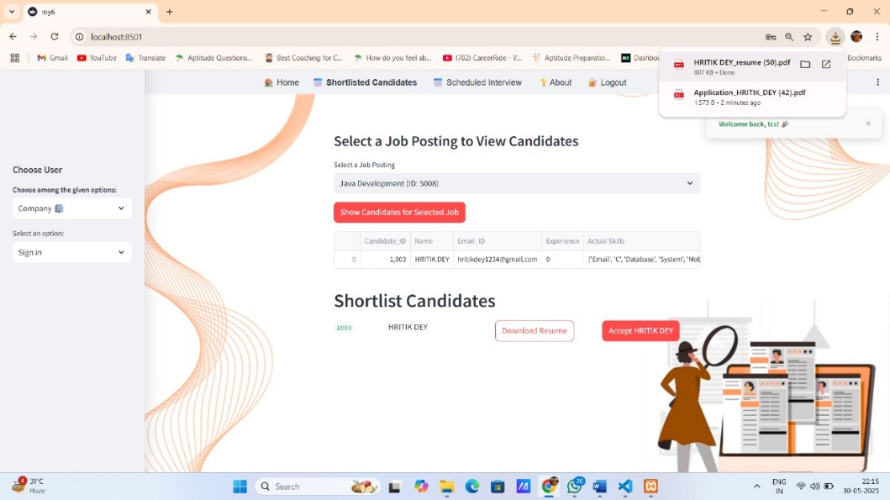
SYSTEM OUTPUT
:Shortlisted Candidate’s
Data in Company side
Download Candidate’s Resume:

Slide 14
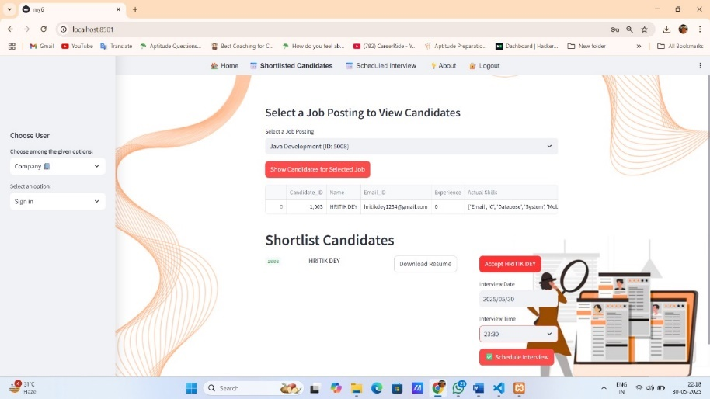
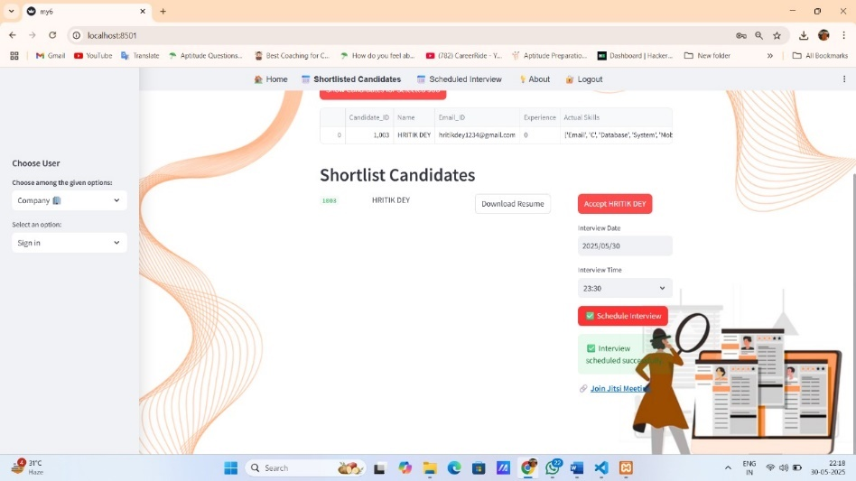
SYSTEM OUTPUT
: Accept & Schedule Interview
Confirmation message with an
interview meeting link:

Slide 15
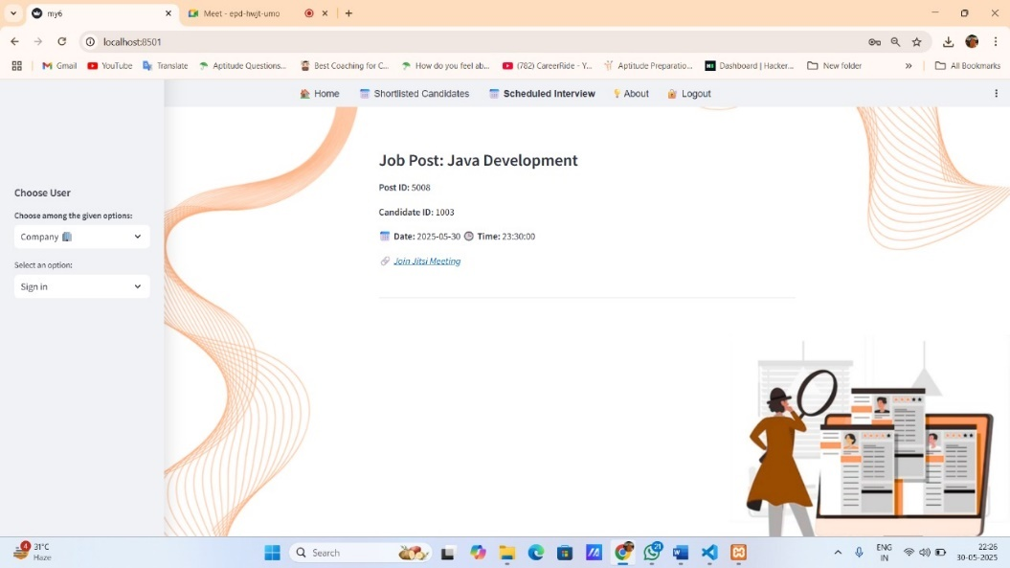
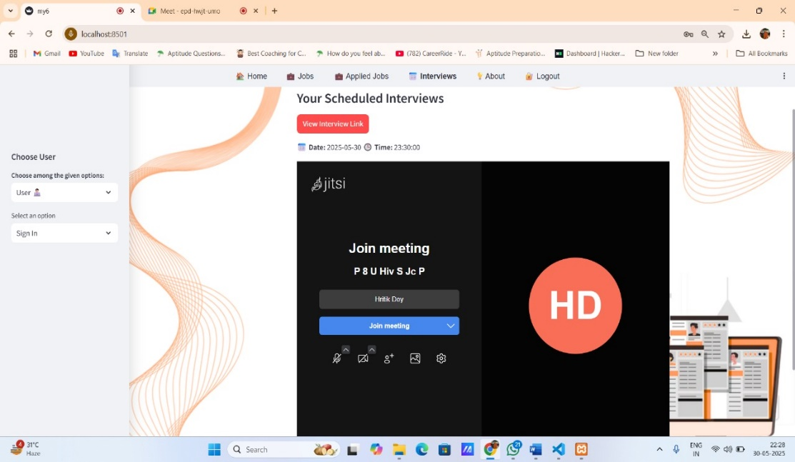
SYSTEM OUTPUT
: Get Meeting Link at company side
Join Meeting from applicant’s side:

Slide 16
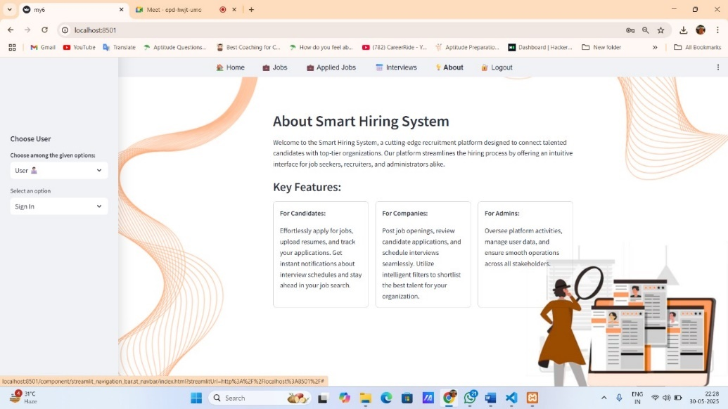
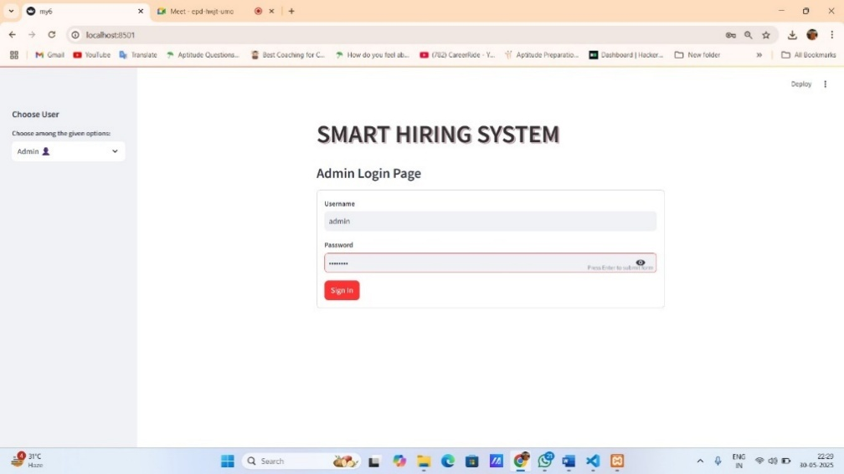
SYSTEM OUTPUT
:About Our Application
Admin Login Page:

Slide 17
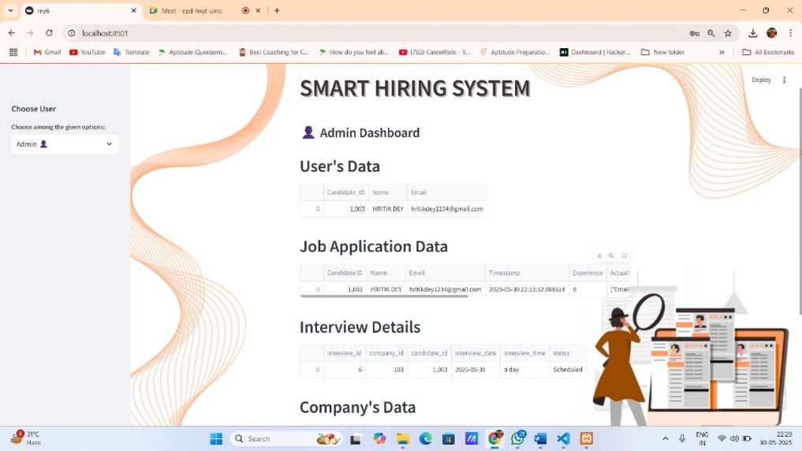
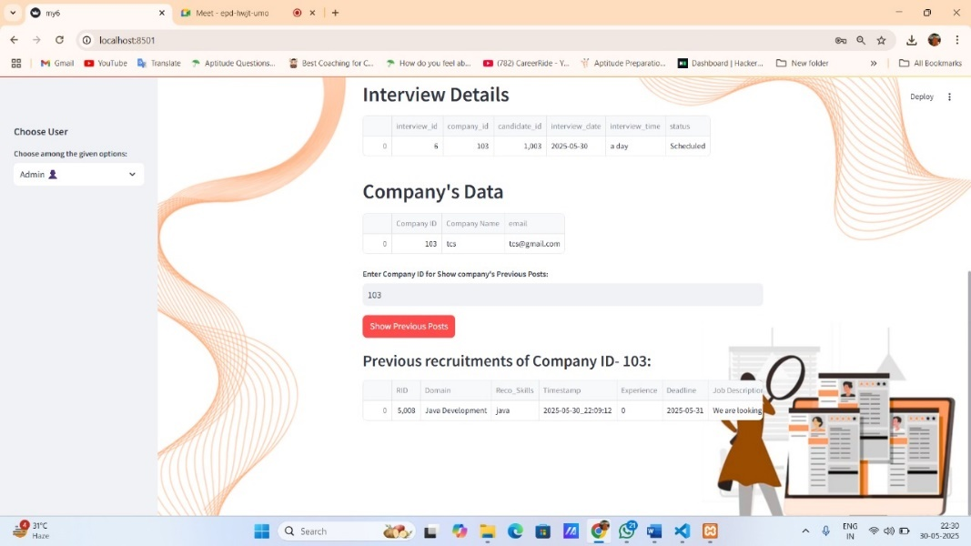
SYSTEM OUTPUT
: View all Details
Check Previous
Recruitments by a
Company:

Slide 18
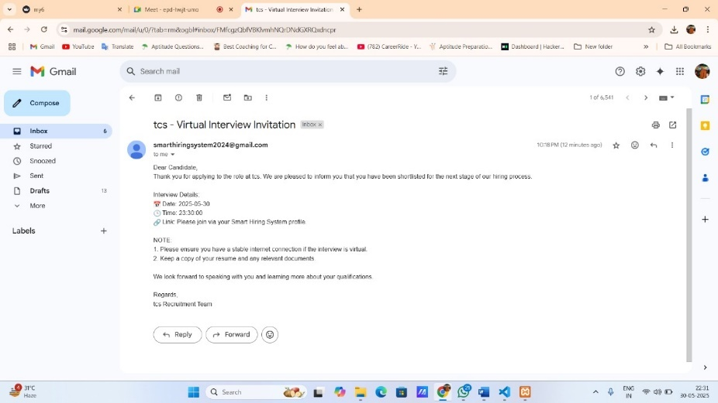
SYSTEM OUTPUT
Interview Mail

Slide 19
POSITIVE ASPECTS
1. Customizable Job Criteria: Hiring managers can set requirements by using pre-define components for specific skills, experience levels, and other requirements.
2. Enhanced Candidate Screening: Uses AI to screen and evaluate candidates based on skills and experience .
3. Transparent Communication: Notifies users at every stage of their application with autogenerated emails and downloadable application reference PDF.
4. Integrated Interview Scheduling: send interview link to candidates and schedules interviews directly within the app.
5. Role-Based Interfaces: Distinct portals for users, companies, and administrators enhance usability and control.

Slide 20
LIMITATIONS
1. Customization: While the system supports customizable job criteria but it is relied on few dynamic requirements Limited and may not cater to all unique requirements or workflows of different companies.
2. Limited Interview Flexibility: The system integrates virtual interviews, which may lack advanced features compared to premium video conferencing tools..
3. Resume Parsing Errors: Issues with extracting information accurately from resumes with non-standard formats.

Slide 21


CONCLUSION
Smart Hiring System streamlines and automates the recruitment process, making it faster, more efficient, and fairer for all stakeholders. By leveraging automation, NLP-based resume parsing, and dynamic skill-matching algorithms, the system reduces manual effort and improves accuracy in candidate evaluation. Its user-friendly design ensures seamless interaction for job applicants, hiring managers, and administrators, while robust security measures safeguard sensitive data. With its scalability, inclusivity, and focus on fairness, the system addresses key challenges in traditional hiring methods, providing a reliable and modern solution for the evolving recruitment landscape.

Slide 22
THANK YOU

